Slide 1
Redefining
the Social Community
Presented by Grace Pai
Notes:
Hello,
This pitch is intended to sell an idea and gain funding to explore a problem that has been growing within online social communties for a few years now.

Slide 2
1+ Billion Hours Viewed in 1 Day
Notes:
I want to take this time to point out one of the biggest social platforms available globally. Youtube.
They are available in 91 countries with 80 supported languages, leading to over 1.9 Billion Monthly active Users.
With so many active users, it is not a surprise that they have over one billion hours of videos viewed every day.
To give you a comparison, Twitch, a streaming site for gamers, reached a little under a billion view hours the entire month of May.
https://twitchtracker.com/statistics

Slide 3
Over $2 Billion Paid to Content Creators Through AdSense in the Past 5 Years
Notes:
One of the main driving factors of YouTube’s success is their symbiotic relationship with their content creators.
More specifically, one of their most successful features is their AdSense Program. With this program, Youtube has accounted for 11% of Google’s net U.S. ad revenues while creators are able to bring in money from the videos they create. Sometime even enough money to make YouTubing their full time career.
https://www.feedough.com/youtube-business-model-how-does-youtube-make-money/
https://www.youtube.com/yt/about/press/

Slide 4
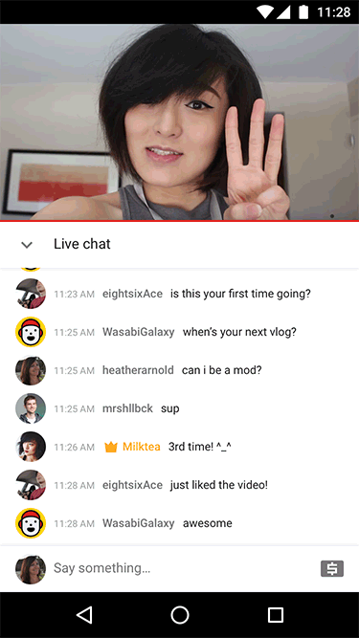
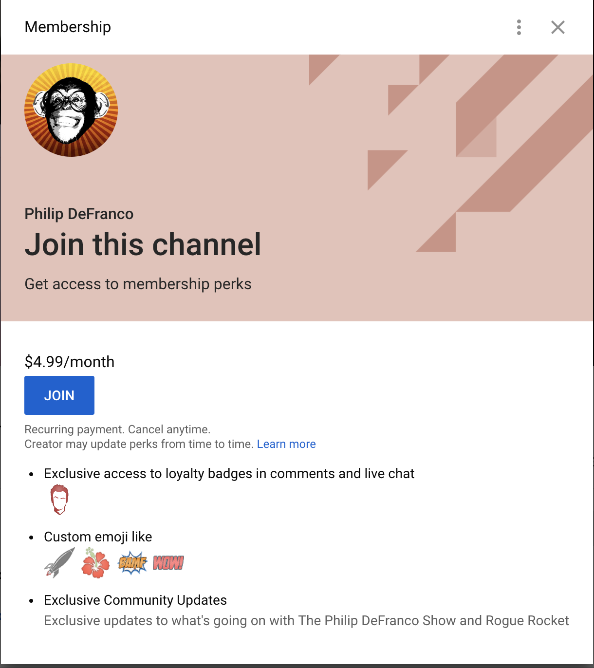
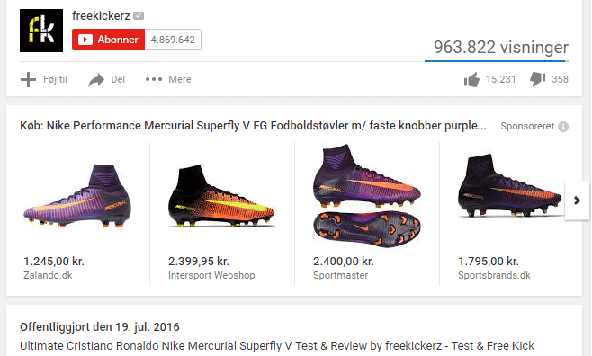
Community Tools
Notes:
But, Ads aren’t the only thing that keeps creators on the site.
With the digital community growing stronger and stronger each year, Youtube has been releasing features aided to bring more monetary and engagement support for the creator’s community
From Memberships, links to creators’ merchandise, and to super chats during live streams, you can see the platform has put time and resources into creating more engagement opportunities between a creator and their community

Slide 5
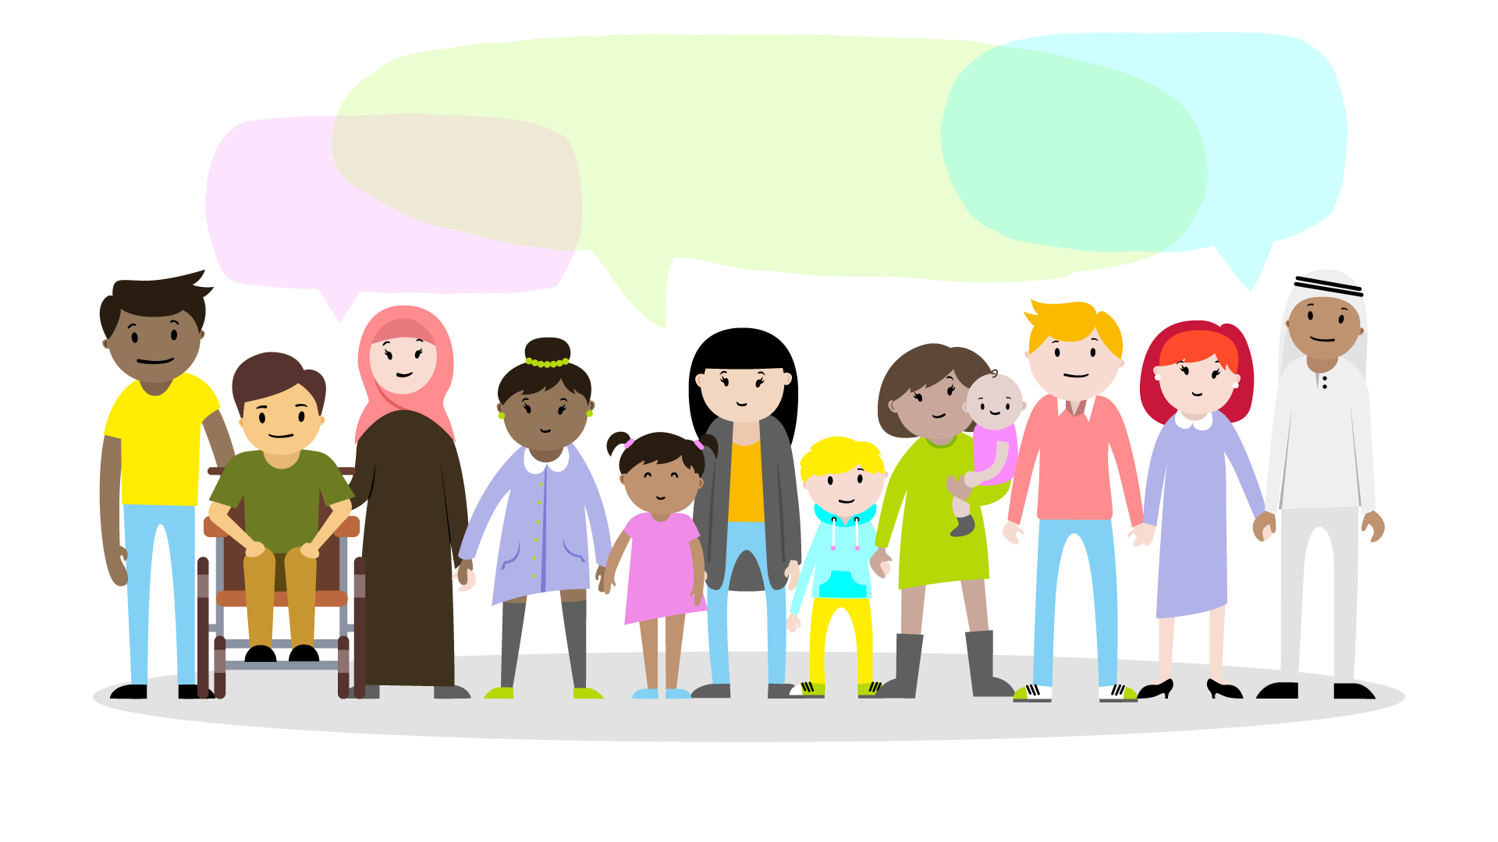
100 million people take a social action every week
Notes:
Unfortunately, there is one part of the platform that seems to have slipped through the cracks of technological advances and evolution.
The comments section.
Over 100 million people take a social action every week. This means they are liking a video, sharing a video, or commenting on a video.
https://www.jeffbullas.com/35-mind-numbing-youtube-facts-figures-and-statistics-infographic/

Slide 6
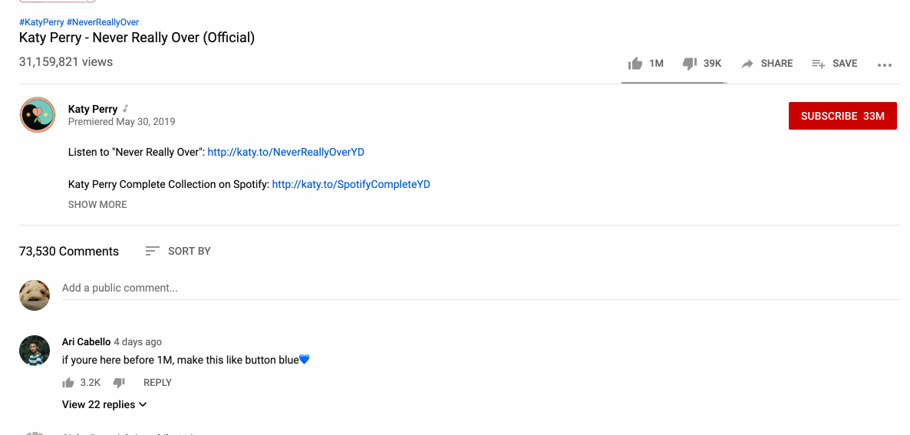
4 Days since release & already 73,530 Comments
Notes:
Take Katy Perry’s latest Music Video.
She released it only 4 days ago and has already amassed over 73k in comments.
The big question is, will you be scrolling through all those comments?
Millions of community members are trying to fight for their comment to catch the attention from others within the community. Unfortunately, because it’s millions, all of the comments become drowned except for the top 5 to 10.

Slide 7
Comment Drowning
Hate Speech
Child Predators
Cyber-Bullying + Trolling
Notes:
Comment drowning, unfortunately, is just the tip of the iceberg. There are much more serious problems occurring within the comments section that YouTube and other mega social platforms like Twitter and Facebook have yet to find an appropriate solution for in moderating.
Just to name a few examples,
CSPAN had to disable commenting on their live streams for certain topics because hate speech could not be prevented.
YouTube made the temporary decision to disable all commenting on family vlog channels to prevent child predators from posting inappropriate comments on their children.
Finally, go to any video, and you can find community members attacking each other or trolling each other.
In the end, there’s room for improvement and that improvement was needed yesterday.

Slide 8
Automation
Moderation
Grouping Repetitive Topics
Customized quick response
The key to success
Notes:
What should be done?
Automation. We should explore stepping away from a free for all commenting environment to an environment that is more user friendly and conducive to engagement.
How should we do this?
Automate moderation. Anything that might be harmful, hatful, or harassing should be hidden or completely removed based off user preference.
Automate the grouping of repetitive topics so the range of topics significantly increase
Finally, automate customized quick responses. Similar to how you can add Slack Emoji Response, we can add comment responses that have been mentioned multiple times for the video.
By doing this, not only would there be a cleaner and safer community, but also, the community will be more engaged.
Treat it like a funnel
Automation is key:
To moderate negative comments based off of keywords, something that is always learning for the new slang that adopted
To group comments into topic groups, either based of repetitive comments like quoting
Add automated response types
Impact:
Cleaner and more importantly safer Commentary
Increase engagement by making the comments section more organized and less daunting to read through

Slide 9
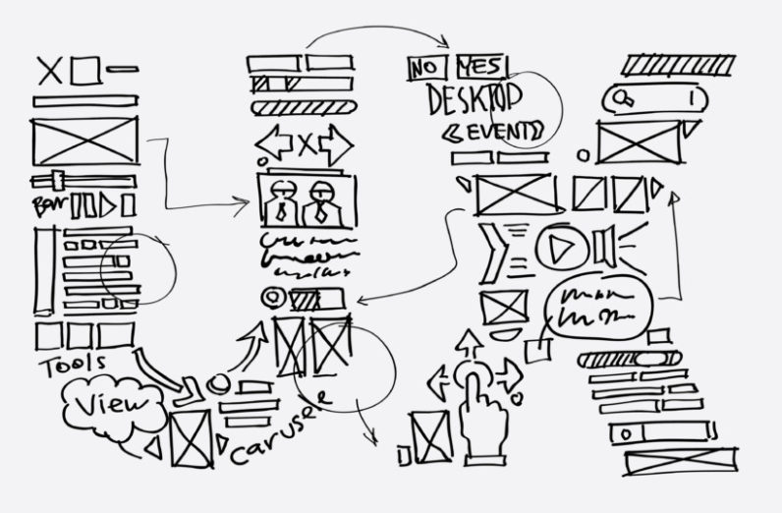
Invest $450,000
Get a working prototype with real world data in 1 year
Notes:
Needs
UX Researcher - $84,595
UX Designer - $80,928
Front End Developer - 90,000
Back End Developer - 120,000
IT - 25,000
Shared Office space - WeWork 12,000
Marketing - 37,477
450,000

Slide 10
Notes:
Conclusion

